Slide 1


Students Performance in Exams
Group 8
Jason Yu
STAT 5607
Advanced Business
Analytics

Slide 2
Contents
Here’s what you’ll find in this project presentation:
Introduction
Overview of Dataset
Motivation
Objectives
Exploratory Data Analysis
ANOVA
Linear Regression
Summary
Implications

Slide 3


Introduction
Academic success depends on more than just innate abilities or hard work, as factors such as socio-economic status, family background, and culture play a crucial role.

Slide 4

Dataset
The Kaggle dataset "Students Performance in Exams" contains information on students' background and academic scores.
The dataset is useful for exploring relationships between factors and academic achievement.
Insights gained from the dataset can inform evidence-based interventions and policies to improve educational outcomes.
https://www.kaggle.com/datasets/spscientist/students-performance-in-exams

Slide 5
Motivation
The "Students Performance in Exams" dataset is a valuable resource for addressing educational and social issues. By analysing the data, policymakers, educators, and researchers can gain insights into the factors that influence academic performance and use evidence-based interventions to improve outcomes for students from different backgrounds.

Slide 6




Objectives
Student performance
Understand the effect of different levels of parental education on students’ math performance
Understand the key predictors that explain the variation in students’ math performance

Slide 7
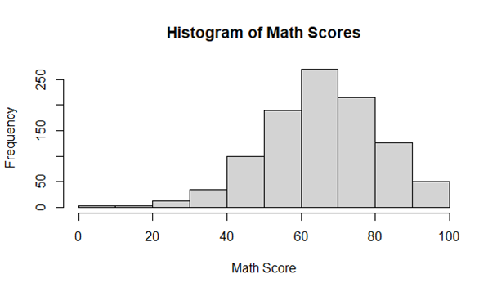
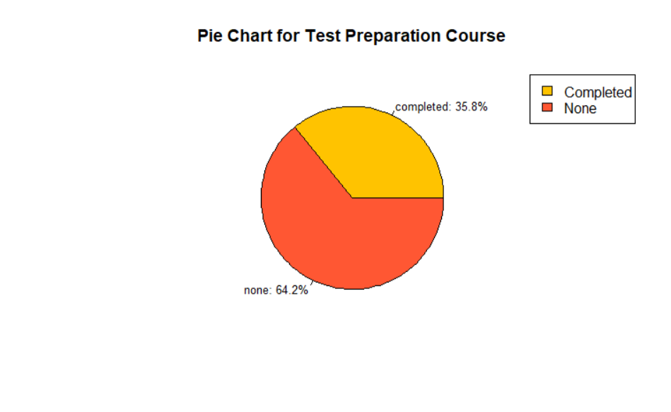

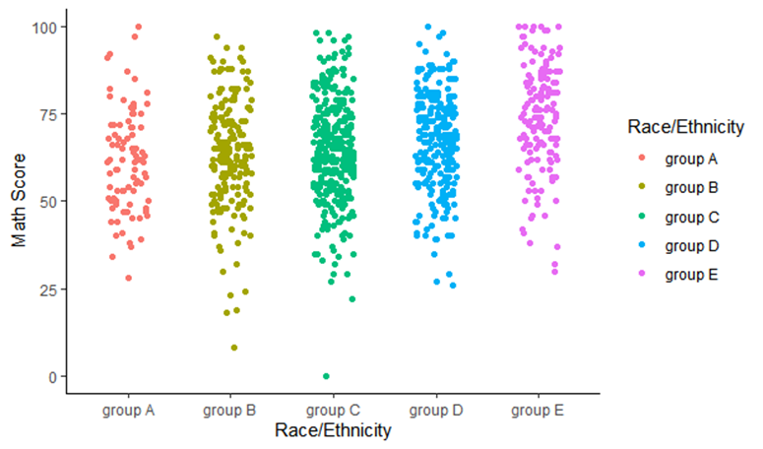
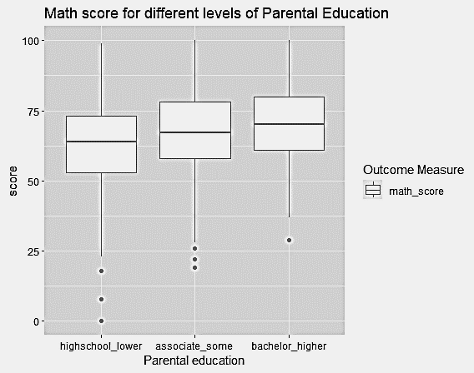
Exploratory Data Analysis
Histogram
Pie Chart
Box plot
Average
Scatterplot

Slide 8



Summary
Standard Deviation
Histogram
Unimodal
Roughly symmetric
Few outliers toward the left end
Does not need scaling

Slide 9
Average math score by gender
Male students performed better on Math test.

Slide 10
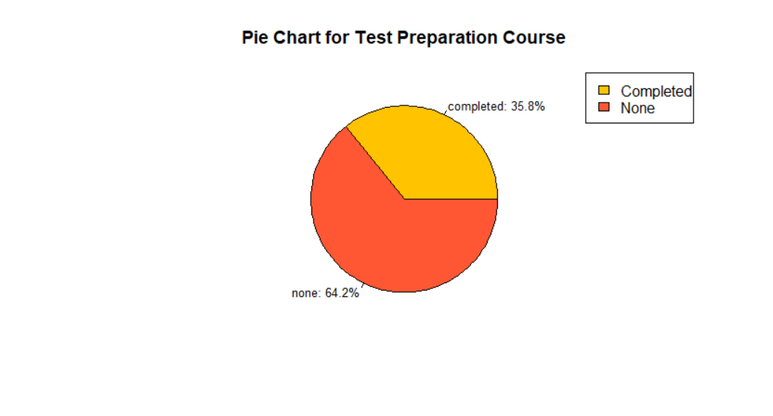
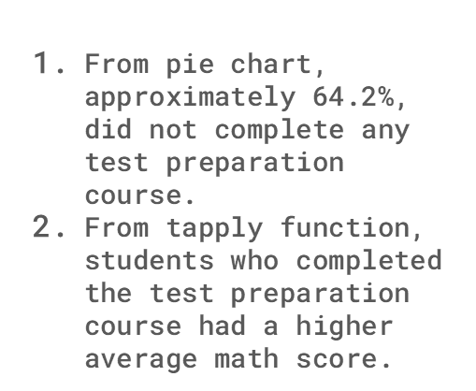
Pie chart

Slide 11
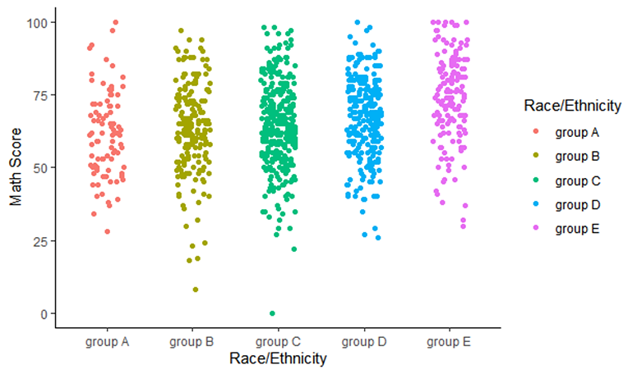
Scatterplot
Mean math score is similar across all racial groups

Slide 12
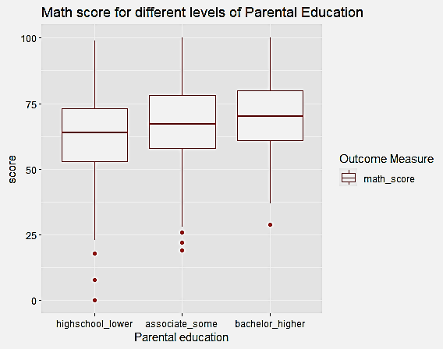
Box plot
Combined 6 levels to 3 levels
Bachelor/master degree
Associate degree or some college
High school graduate or some high school
Mean math score is different across levels of parental education

Slide 13
ANOVA
Purpose: To test whether the mean math score for students is same across all levels of parental education
Planned contrast
High school graduate or lower vs other
Bachelor or higher vs associate or some college
Hypotheses: students who are from family with higher parental education will perform better on math exam

Slide 14
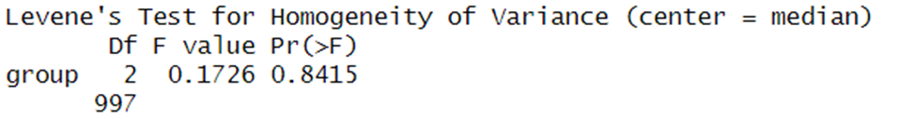
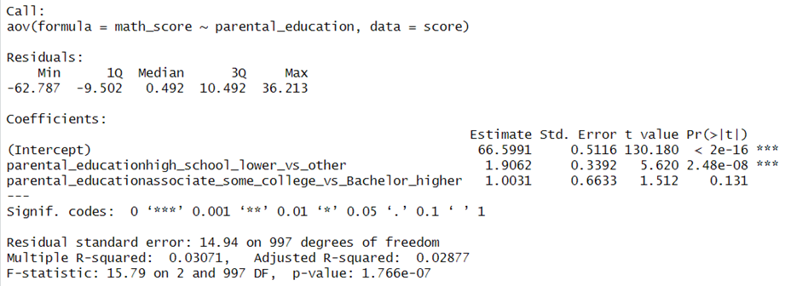
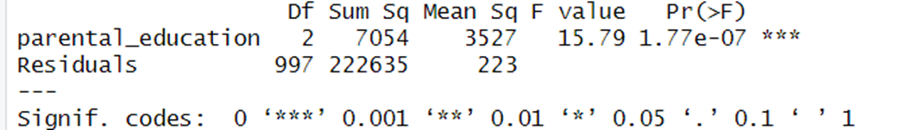
ANOVA
The assumption of homogeneity of variance has been met.
Contrast one is significant
Contrast two is not significant
Mean math score for students differs significantly across different levels of parental education

Slide 15
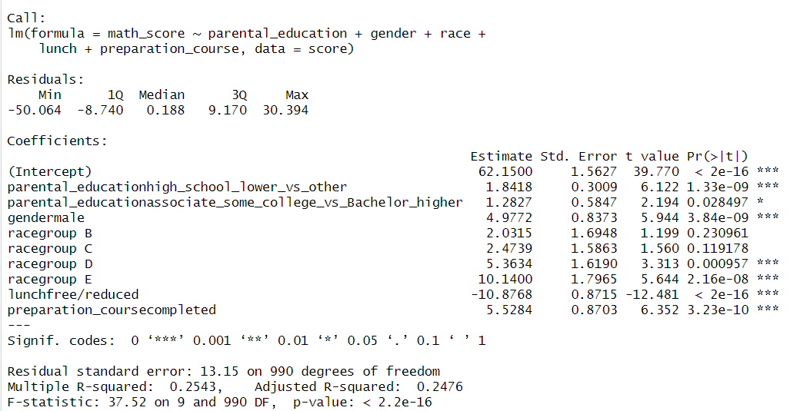
Linear Regression
Purpose: Understand the key predictors that explain the variation in students’ math performance

Slide 16
25%
Adjusted R-Squared

Slide 17
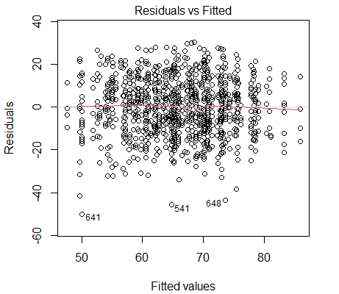
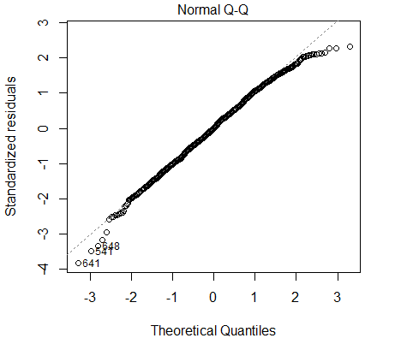
Linear Regression
Homoscedasticity test
Normal Quantile Plot

Slide 18
Summary
ANOVA:
Features – Parental Education
Students whose parents have attained some college experience or higher tend to acquire higher math score compared to students whose parents have a high school diploma or lower.
Linear Regression:
Significant Features: Parental Education, Gender, Race, Lunch, Test Preparation
Students whose parents have attained bachelor's/master's degree tend to acquire higher math scores compared to students whose parents have associate's degrees or some college experience.

Slide 19
Implications
Students who completed Preparation tests tend to score higher in math
Male Students tend to score higher in math
Students having standard Lunch tend to score higher than the students who have free/reduced lunch.
Students from Race E and D groups tend to perform better than Race A

Slide 20

Thanks!

